Slide 1

COS100026
Aevina AI
Web Application
3AEVN Present

Slide 2

Introduction
Aevina AI is a web application for managing job applications and HR processes.
Objectives:
Develop a secure Manager Authentication System (login.php, register.php)
Enhance functionality in manage.php (EOI management features)
Implement advanced enhancements (e.g., lockout, session timeout)

Slide 3

Project Scope and Contributions
Khanh:
HTML to PHP files transformation for modularisation
Login page
Lockout mechanism
John:
Apply page sanitisation
EOI Table page
Register
Viet Hoang:
Manage page
Job Page database incorporation

Slide 4
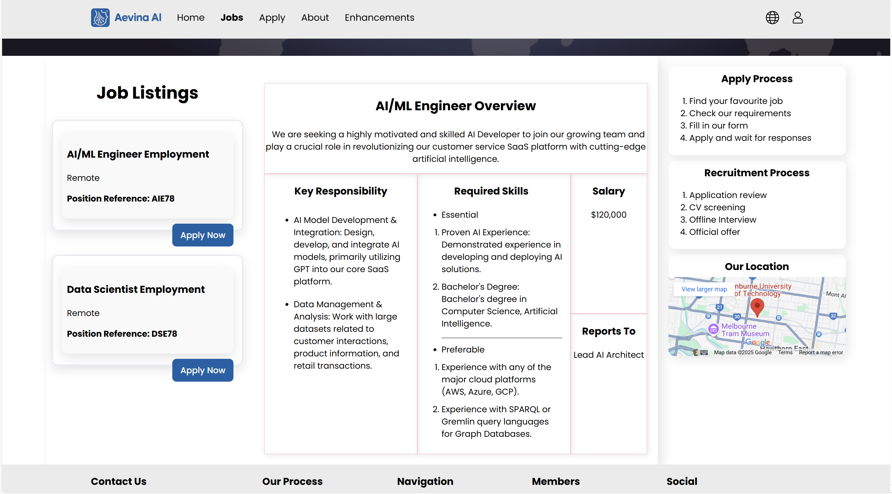
Job Pages (jobs.php)
Summary
Successfully developed a dynamic jobs listing page using PHP and MySQL.
Integrated job details display with both desktop and mobile-friendly views.
Embedded a Google Map for location reference.
Used semantic HTML and organized structure for accessibility and clarity.
Achieved a responsive and styled layout with correct CSS targeting using $currentPage.
Achievement
Exceeded basic requirements with responsive design and clean UI.
Demonstrated technical understanding in PHP, SQL, HTML5, and CSS3.
Aiming for HD with additional functionality, structure, and real-world features.

Slide 5
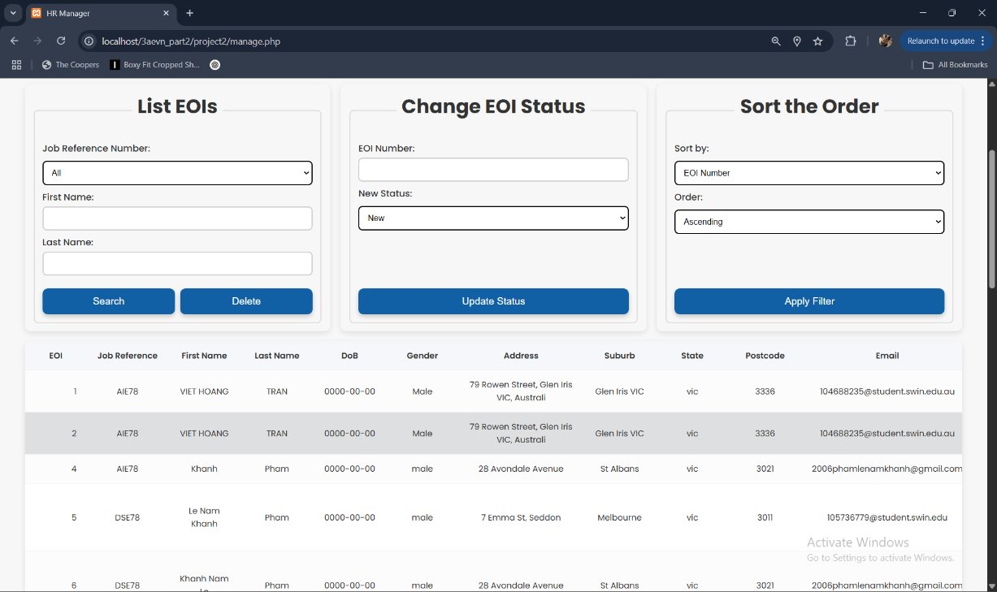
EOI Management System
Purpose: Allow managers to manage Expressions of Interest (EOIs).
Features:
List all EOIs (SELECT * FROM eoi).
Filter by job reference number, first name, last name.
Delete EOIs by job reference number with confirmation.
Update EOI status (New, Current, Final).
Additional feature: Sort by EOInumber or Status (ascending/descending).
Technical Details:
Dynamic SQL queries with sanitization (sanitize_input()).
Responsive table display with display_results().
Why It’s Advanced: Sorting feature goes beyond requirements, enhancing usability.

Slide 6
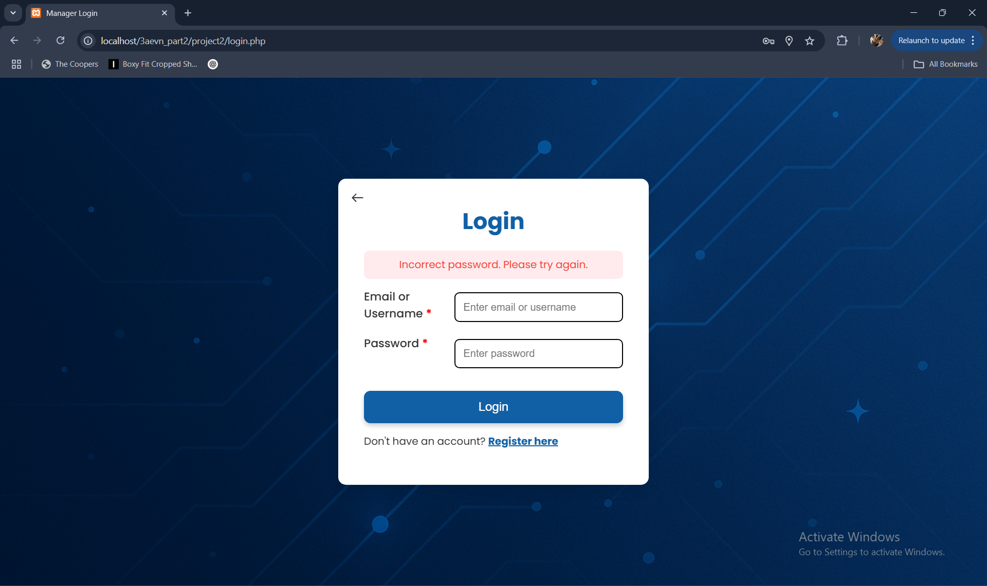
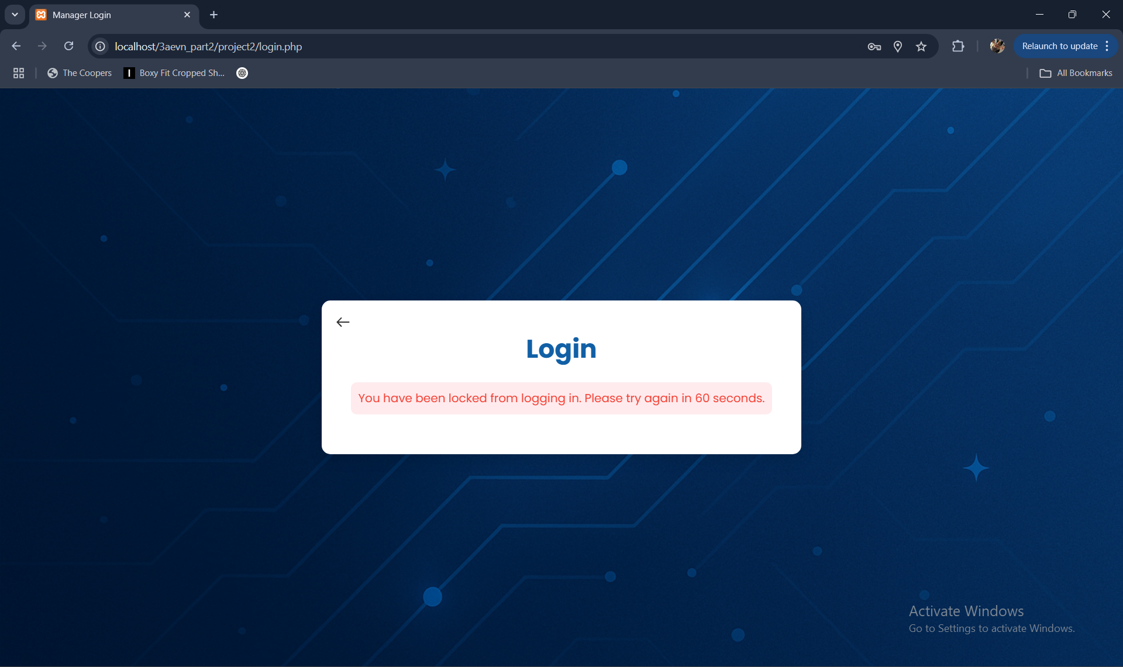
Manager Authentication System
Purpose: Secure login for managers to access manage.php.
Features:
Login form accepting username or email (login.php).
Password verification with password_verify() (process_login.php).
Lockout after 3 failed attempts (60-second duration).
Technical Details:
Sanitization with mysqli_real_escape_string() and htmlspecialchars().
Session management to store manager_id, first_name, last_name, email.
Why advanced? Lockout mechanism enhances security against brute-force attacks.

Slide 7
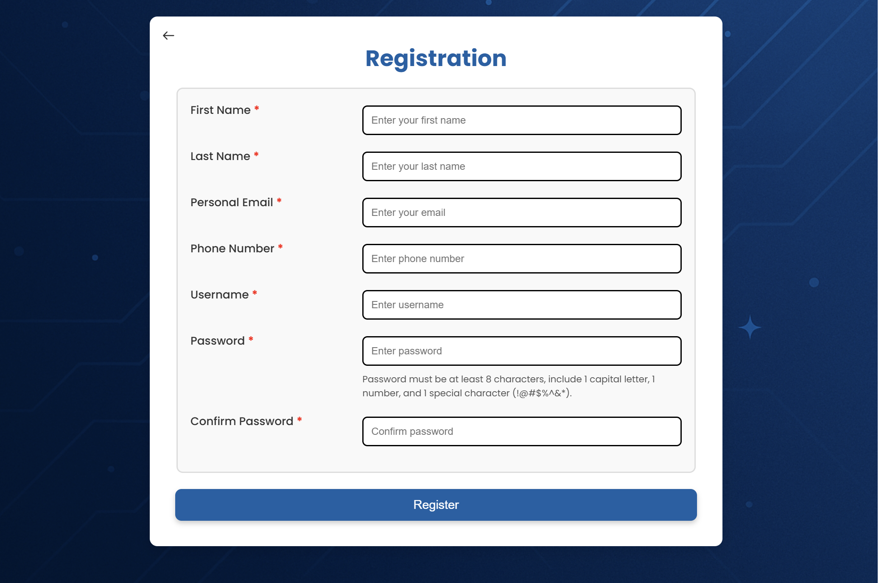
Registration System (register.php) Manager Registration
Purpose: Allow managers to create accounts securely.
Features: Form with fields: first name, last name, email, phone, username, password, confirm password.
Password validation (min 8 characters, 1 capital, 1 number, 1 special character).
Displays session-based error messages (e.g., password mismatch).
Technical Details: Uses HTML5 validation (pattern) and session to retain form data on error.
Password hashing (assumed in process_register.php with password_hash()).
Why It’s Useful: Ensures only authorized managers can access the system.

Slide 8
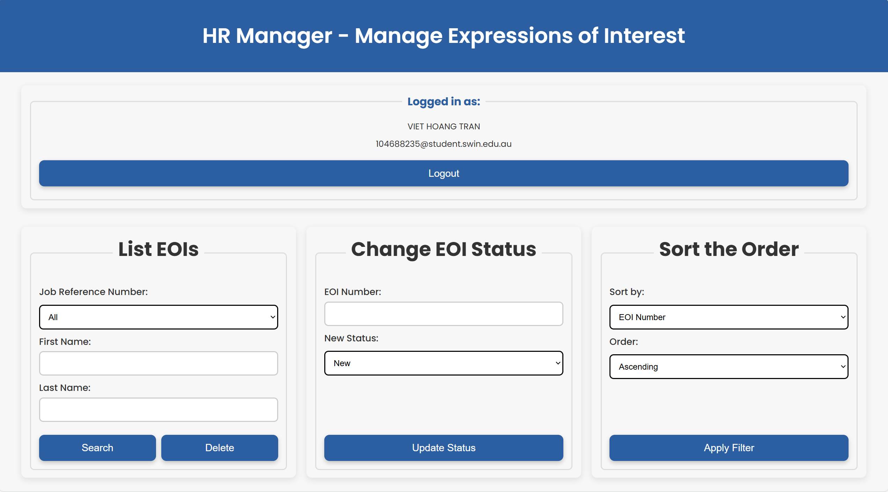
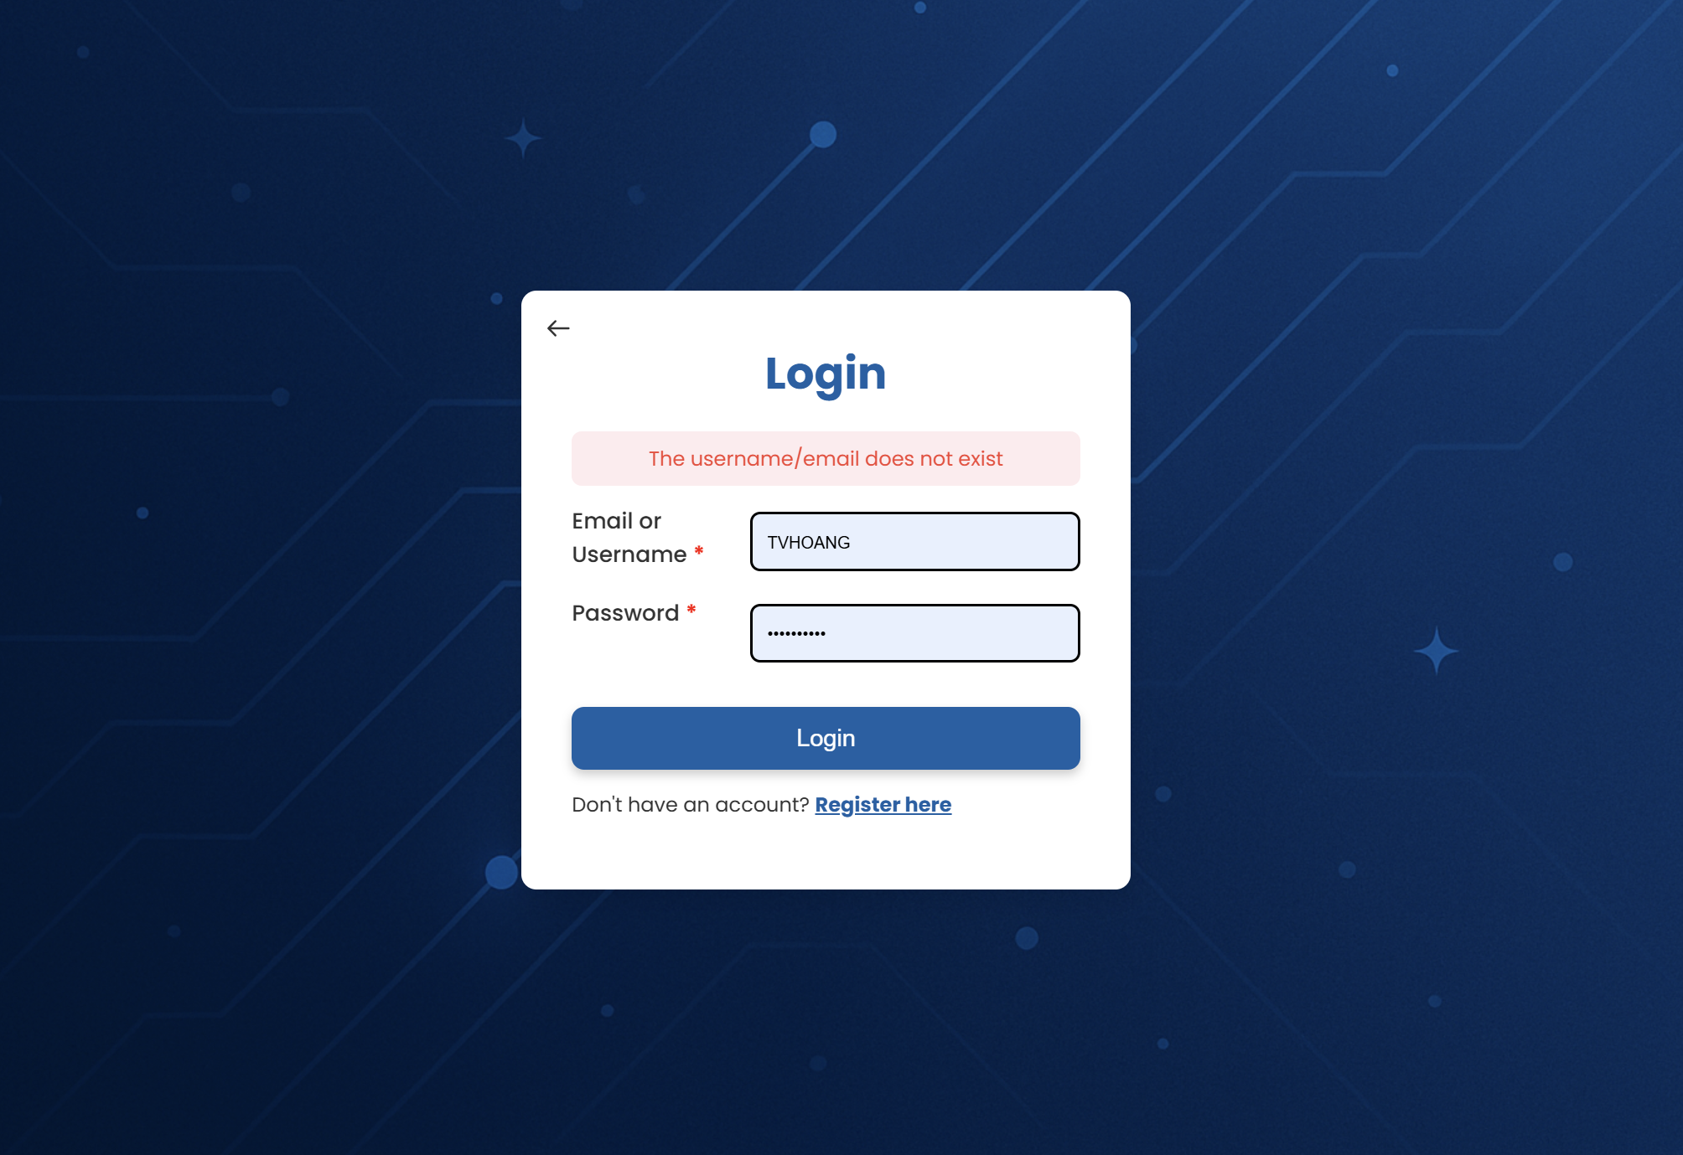
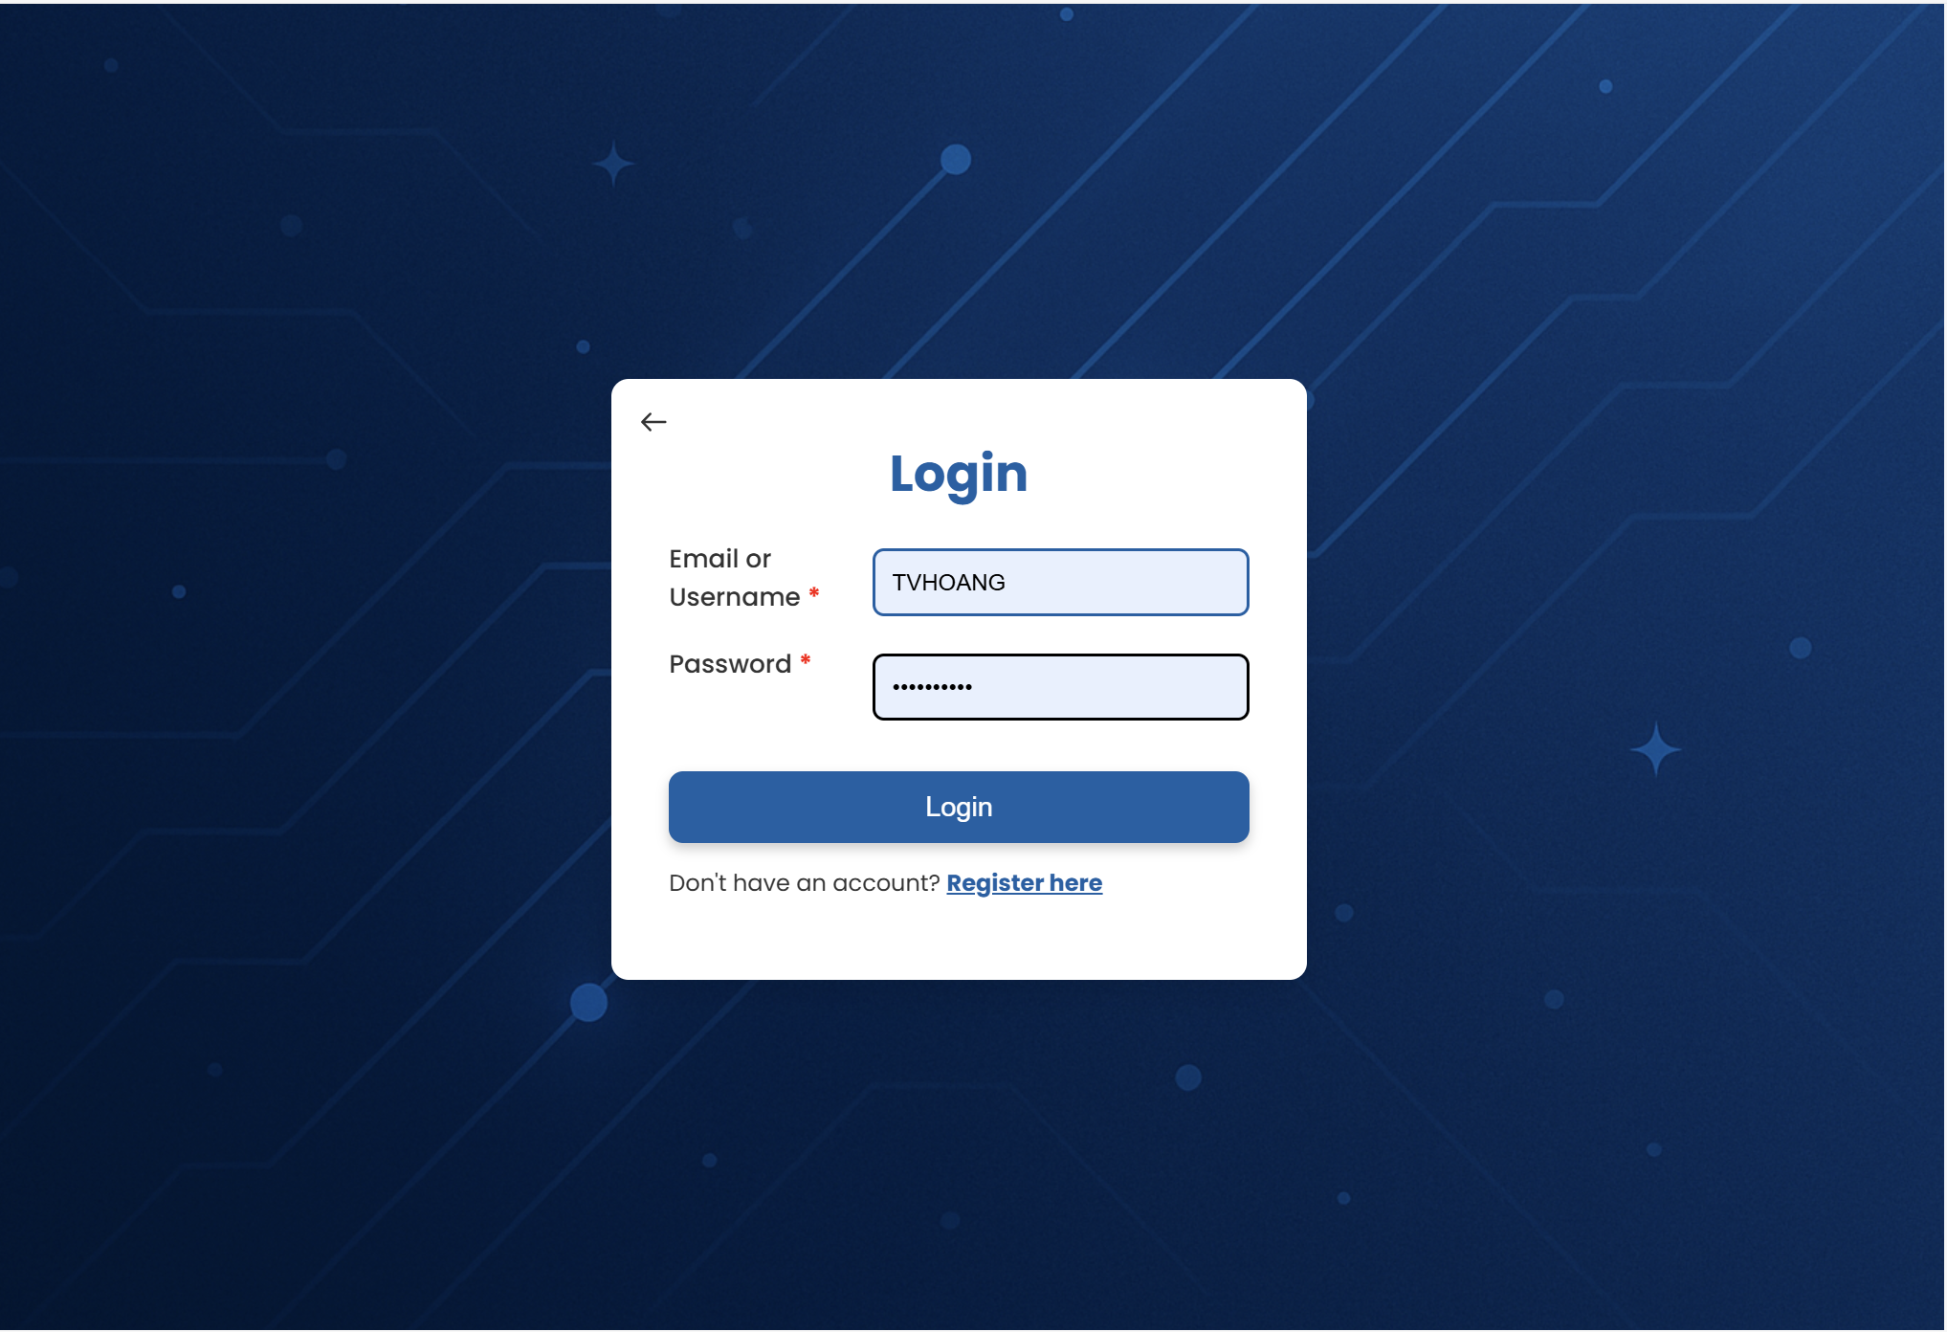
Enhancements and Security Features Enhancements and Security
Enhancements (from enhancements.php):
Lockout Mechanism: 60-second lockout after 3 failed login attempts.
Session Management: 30-minute inactivity timeout and session ID regeneration.
Data Validation: Sanitization across forms (sanitize_input()).
Security Features: Password hashing with password_hash() and password_verify().
Input sanitization to prevent SQL injection and XSS.
Why It’s Advanced: Goes beyond basic requirements with lockout and timeout features. Enhances security and user experience.

Slide 9
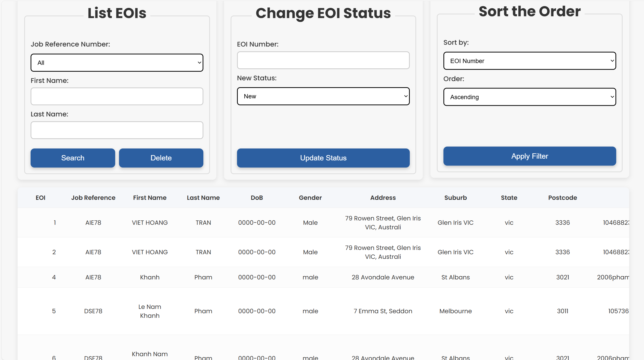
Challenges and Solutions
Challenge 1: Ensuring secure login with lockout. Solution: Implemented login_attempts counter and lockout_time in process_login.php.
Challenge 2: Preventing SQL injection in manage.php. Solution: Used sanitize_input() with mysqli_real_escape_string().
Challenge 3: Making manage.php user-friendly. Solution: Added sorting, responsive table design, and confirmation dialogs. Highlight creativity: "Added sorting feature to manage.php, which wasn’t required but improves usability."

Slide 10

Conclusion and Future Improvements
Summary:
Successfully implemented a secure authentication system and EOI management features.
Added advanced enhancements (lockout, session timeout, sorting).
Met all rubric criteria with additional functionality.
Future Improvements:
Use prepared statements for SQL queries to enhance security.
Add CSRF tokens to forms for additional protection. Implement email verification for registration.
Achievement: "Aiming for HD by surpassing requirements with technical excellence and creativity."

